Slide 1
Agenda
Personality

Slide 2
True or False?
1. Freud believed that boys develop sexual desires for their mother when they are between 3 and 6 years of age.
2. One of the most reliable and valid measures of personality is the Rorschach inkblot test.
3. Dreams are disguised wish fulfillments that can be interpreted by skilled analysts.
4. Psychologists generally agree that painful experiences commonly get pushed out of awareness and into the unconscious.
5. Most Americans believe that self-esteem is very important for motivating a person to work hard and succeed.

Slide 3
True or False?
6. Personality differences among dogs are as evident and as consistently judged as personality differences among humans.
7. Most people recognize that personality descriptions based on horoscopes are invalid.
8. From a few minutes’ inspection of our living and working spaces, someone can, with reasonable accuracy, assess our emotional stability.
9. Older people are happiest when they do not have to take responsibility for everyday decisions that affect their lives.
10. The majority of people suffer from low self-esteem.

Slide 4

An Introduction to Psychological Science
Third Canadian Edition
Chapter 12
Personality
Copyright © 2021 Pearson Canada, Inc.
Notes:
If this PowerPoint presentation contains mathematical equations, you may need to check that your computer has the following installed:
1) MathType Plugin
2) Math Player (free versions available)
3) NVDA Reader (free versions available)

Slide 5

Modules
12.1: Contemporary Approaches to Personality
12.2: Cultural and Biological Approaches to Personality
12.3: Psychodynamic and Humanistic Approaches to Personality
Pearson Education

Slide 6
12.1 Learning Objectives
Know the key terminology associated with contemporary approaches to personality.
Understand the behaviourist and social-cognitive views of personality.
Apply self-report methods to understand your own personality.
Analyze the personality roots of violence and prejudice.
Analyze the relative roles of personality traits and psychological and physical states in determining behaviour.
Notes:
Know the key terminology associated with contemporary approaches to personality.
See the bold, italicized terms below.
Understand the behaviourist and social-cognitive views of personality.
A strict behavioural account of personality identifies the stimuli and situational factors that control the various responses that can be elicited. When this perspective is adopted, there is little use of trait terminology, such as neuroticism or conscientiousness, and no reference to cognitive factors such as beliefs or thoughts. The social-cognitive approach to personality also accounts for situational factors and behaviour, but adds a cognitive element that interacts with the environment in such a way that situations, behaviour, and thoughts are determined in reciprocal fashion.
Apply self-report methods to understand your own personality.
Using Figure 12.1 and Table 12.2, students should be able to reflect on whether they would score low, medium, or high on each trait and give specific examples of behaviours or preferences that support their ranking.
Analyze the personality roots of violence and prejudice.
Researchers identified three sets of factors that predict violence and prejudice that are not fully captured by the Five Factor Model. The first is the Honesty–Humility dimension of the HEXACO model of personality. The second is the Dark Triad of psychopathy, Machiavellianism, and narcissism. The third is Right-Wing Authoritarianism.
Analyze the relative roles of personality traits and psychological and physical states in determining behaviour.
The debate over whether personality traits influence behaviour or whether situational factors play a bigger role in behaviour has been ongoing in the field of personality psychology. In reality, both sets of factors are important. Personality traits can be remarkably consistent, yet the situations we find ourselves in can lead to unexpected behaviour.

Slide 7
Personality Exercise: Who am I?
Describe your own personality by simply answering the question “Who am I?” on a piece of paper. Write at the top of the page “I am . . .” and then list about 20 characteristics that describe you. List what you consider to be some of your own positive and negative personality qualities.

Slide 8
Personality Exercise: Some Terms
sincere, honest, faithful, loyal, modest/unassuming, fair-minded, sly, greedy, pretentious, hypocritical, boastful, pompous, emotional, oversensitive, sentimental, fearful, anxious, vulnerable, brave, tough, independent, self-assured, stable, intellectual, creative, unconventional, innovative, shallow, absentminded
outgoing, lively, extraverted, sociable, talkative, cheerful, active, shy, passive, withdrawn, introverted, quiet, reserved, patient, tolerant, peaceful, mild, agreeable, lenient, gentle, ill-tempered, stubborn, quarrelsome, choleric (easily angered), organized, disciplined, diligent, careful, thorough, precise, sloppy, negligent, reckless, lazy, irresponsible

Slide 9
Approaches to Studying Personality
Personality (p. 458)
Idiographic approach (p. 458)
Serial killer
Person-centred
Nomothetic approach (p. 458)
Descriptive labels
Notes:
1) Psychologists have long searched for a theory of personality that would describe and explain how people develop these patterns of behaviours.
Personality (p. 458) is a characteristic pattern of thinking, feeling, and behaving that is unique to each individual, and remains relatively consistent over time and situations.
2) Some psychologists study personality by using an idiographic approach.
Idiographic approach (p. 458) focus on detailed descriptions of individuals and their unique personality characteristics.
i) This approach might involve a detailed study of a serial killer, someone with a rare talent, or an “average” person.
ii) This approach is unique because it is person-centred and might include how an individual perceives his or her own personality, as well as how others perceive that individual’s personality.
3) Other psychologists are interested in describing personality in terms that can apply to any member of the population.
Nomothetic approach (p. 458) examines personality in large groups of people, with the aim of making generalizations about personality structure.
i) This approach allows psychologists to ask questions about the genetic and cultural basis of personality traits.
ii) This approach typically relies on descriptive labels to identify individuals’ patterns of behaviour.
a) For example, shy vs. outgoing, optimistic vs. pessimistic, etc.

Slide 10
The Trait Perspective
Personality traits (p. 459)
Allport and Odbert
18,000 descriptors
Factor analysis (p. 459)
Notes:
1) According to the trait approach, we can understand individuals—and what makes them alike or sets them apart—based on how well each trait describes that person.
Personality traits (p. 459) are labels applied to specific attributes of personality, such as “shy”, “cheerful”, “outgoing”, and “adventurous.”
i) Several decades ago, Allport and Odbert tallied almost 18,000 words that could be used to describe an individual’s physical and psychological attributes.
ii) Trait researchers use tests that present a list of trait labels and ask an individual to rate how well the trait describes him or her.
iii) Other measures of personality present specific behaviours that represent traits.
a) For example, you might rate your agreement with statements such as “I like to meet new people” to assess how outgoing you are.
2) The advantage of measuring traits through personality tests is that individuals can be described as scoring high or low on a specific trait.
i) For example, you might be considered outgoing and talkative, whereas your roommate is quiet and shy.
ii) However, it’s impractical to assess the applicability of 18,000 attributes for every individual.
a) Factor analysis groups together related traits into a factor, which comprise broad personality trait labels, such as extraversion.
Factor analysis (p. 459) is used to group items that people respond to similarly.

Slide 11
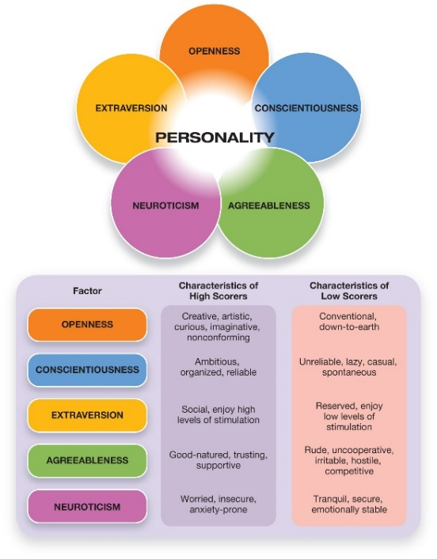
The Five Factor Model
Figure 12.1 The Big Five Personality Dimensions
A widely used measure of personality is the NEO Personality Inventory (NEO-PI-R). Individuals rate themselves on multiple questions that reflect the traits of openness, conscientiousness, extraversion, agreeableness, and neuroticism. (To help you remember the Big Five, note that the first letters of the traits spell out OCEAN.)
Notes:
1) Raymond Cattell (1946) used factor analysis to narrow the 18,000 traits down to 16 key personality traits.
2) McCrae and Costa (1987), creators of the NEO Personality Inventory, found that personality could be reduced to five major dimensions called the Five Factor Model (Figure 12.1).
Five Factor Model (FFM) (p. 460) (also called the Big Five personality factors) is a trait-based theory of personality based on the finding that personality can be described using five major dimensions: extraversion, emotional stability (also referred to by the opposite quality, neuroticism), conscientiousness, agreeableness, and openness.
i) The most recent version of the NEO is the NEO PI-R: Neuroticism, Extraversion, Openness Personality Inventory—Revised.
ii) Responses on the Big Five can predict many real-world behaviours.
a) For example, extraverted people tend to report happier moods than introverts and are more likely to achieve high status in student groups (e.g., sororities).
b) However, extroverts are also more prone to risk taking and substance abuse problems.
c) Those high in conscientiousness tend to have positive health-related behaviours, longevity, and high levels of achievement.
Long Description:
The 5 dimensions are as follows.
1. Openness
2. Conscientiousness
3. Extraversion
4. Agreeableness
5. Neuroticism
The chart also lists the characteristics of the high and low scorers of each of the dimensions as follows.
• Openness
• High scorers: Creative, artistic, curious, imaginative, nonconforming
• Low scorers: Conventional, down-to-earth
• Conscientiousness
• High scorers: Ambitious, organized, reliable
• Low scorers: Unreliable, lazy, casual, spontaneous
• Extraversion
• High scorers: Social, enjoy high levels of stimulation
• Low scorers: Reserved, enjoy low levels of stimulation
• Agreeableness
• High scorers: Good-natured, trusting, supportive
• Low scorers: Rude, uncooperative, irritable, hostile, competitive
• Neuroticism
• High scorers: Worried, insecure, anxiety-prone
• Low scorers: Tranquil, secure, emotionally stable

Slide 12
Beyond the Big Five: The Personality of Evil?
Authoritarian Personality
HEXACO (p. 462)
Honesty-Humility
The Dark Triad (p. 462)
Machiavellianism
Psychopathy
Narcissism
Right-wing authoritarianism (p. 463)
Notes:
1) Authoritarian personality:
i) Authoritarians were theorized to be rigid and dogmatic in their thinking, to separate their social world into strict categories of “us” and “them,” and then to believe strongly in the superiority of “us” and the inferiority of “them.” As a result, authoritarians were more likely to endorse and engage in prejudice and violence, particularly towards people in the “them” category.
2) The HEXACO model of personality (p. 462) is a six-factor theory that generally replicates the five factors of the FFM and adds one additional
factor:
i) Honest-Humility: Individuals scoring highly on this factor (high HHs) tend to be sincere, honest, faithful and modest, whereas those with low scores (low HHs) are deceitful, greedy, and pompous.
3) The Dark Triad (p. 462) includes Machiavellianism, psychopathy, and narcissism—describe a person who is socially destructive, aggressive, dishonest, and likely to commit harm in general.
i) Machiavellianism is a tendency to use people and to be manipulative and deceitful, lacking respect for others and focusing predominantly on one’s own self-interest.
ii) Psychopathy is a general tendency toward having shallow emotional responses.
iii) Narcissism reflects an egotistical preoccupation with self-image and an excessive sense of self-importance.
4) Right-wing authoritarianism (p. 463) is a problematic set of personality characteristics that also predisposes people to certain types of violent or anti-social tendencies. RWA involves three key tendencies:
i) Obeying orders and deferring to the established authorities in a society
ii) Supporting aggression against those who dissent or differ from the established social order
iii) Believing strongly in maintaining the existing social order

Slide 13
Working the Scientific Literacy Model: Right-Wing Authoritarianism at the Group Level (1 of 2)
What do we know about RWA?
More RWA in society – leads to prejudice, aggression
How can science determine how RWA affects groups?
Global Change Game
Notes:
1) What do we know about RWA?
i) Personality researchers have identified RWA as a cluster of characteristics that make society a less warm and friendly place. One would expect that the more RWAs in a society, the more intolerance and inter-group aggression will plague that society.
2) How can science determine how RWA affects groups?
i) Altemeyer selected high and low RWAs to play a complex role-playing simulation of the Earth’s future, called the Global Change Game. This game is generally played by 50-70 people who are organized into groups that represent different regions of the world; these groups then make decisions about how their region behaves on the international stage. The simulated conditions of the Earth change depending on the actions of the players, thus providing a realistic simulation of the challenges of governance in the international community.
ii) In order to test how RWAs play the game, Altemeyer ran through the game two times, once with 67 individuals who scored very low on the RWA scale, and once with 68 people who scored very high. Each simulation covered 40 years of time into Earth’s future. The results were astonishing.
a) In the low RWA group, there were no wars or military build-up over the 40-year time period. Instead, regions steadily downsized their militaries and diverted the money into humanitarian and environmental projects. They also collectively resolved challenges through international meetings and cooperation. By the end of the game, food, health services, and jobs were provided for almost all people on Earth, resulting in a peaceful, stable world.
b)In the high RWA group, players tended to interpret the actions of others as aggressive and responded in kind. Militaries quickly grew and war ensued, leading to a global nuclear war that killed every person on the planet. At this point, the players were given a second chance to play, starting at a point prior to the nuclear war. Despite having the chance to learn from their earlier mistakes, the players nevertheless were incapable of getting along with each other. When the ozone crisis occurred, no international summit was called and no region except Europe took action to avert the crisis. Instead of cooperation, players remained suspicious of each other and rapidly developed their militaries.

Slide 14
Working the Scientific Literacy Model: Right-Wing Authoritarianism at the Group Level (2 of 2)
Can we critically evaluate this research?
External validity
Chance
Student participants
Why is this relevant?
21st century warning bell
Notes:
3) Can we critically evaluate this research?
i) First, there are external validity concerns; for example, playing a game with no real consequences does not necessarily indicate how people would respond in a real-life situation. It is possible that in a real situation, people would be more sensitive to the consequences of their actions, and would not be so willing to risk human lives.
ii) Furthermore, the simulations were only performed on one night with each group; therefore, results could have been due to chance factors, such as particular individuals having a strong impact on the outcomes.
iii) Also, because only university students participated in the study, the results may not generalize to the rest of the population.
4) Why is this relevant?
i) This research illustrates the highly destructive impact that authoritarian personalities can have in group settings, and sounds a clear bell of warning in the 21st century.

Slide 15
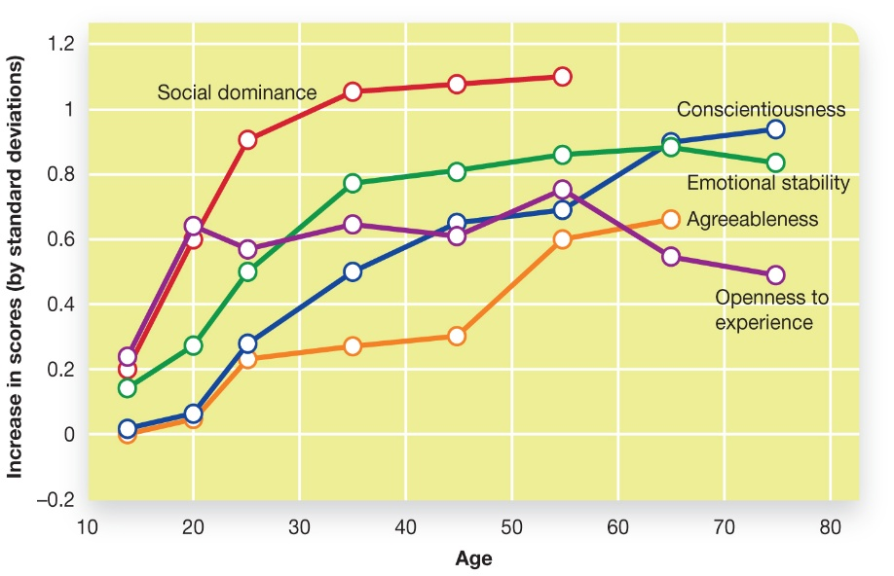
Personality Traits over the Life Span
Figure 12.2 Personality Stability and Change over the Lifespan
Average scores of Big Five traits change over the lifespan. Generally, most traits become more positive through adulthood, although there are anomalies. Social dominance (an aspect of extraversion) remains stable after age 40. Conscientiousness does not begin rising until after the traditional college years. Openness to experience only rises up to the traditional university years, then remains largely stable until old age, when it declines (Roberts et al., 2006).
Notes:
1) Within their first few months of life, infants do show the beginnings of personality characteristics.
i) Temperament refers to personality-like attributes that appear to be present at birth, and includes such characteristics as activity level, mood, attention span, and distractibility.
2) The temperament styles found in infancy seem to represent an innate, biological substrate upon which personality is built.
i) Infant temperament predicts the adult personality traits of neuroticism, extraversion, and conscientiousness.
3) Although there is consistency between temperament and personality, it does not mean that personality cannot change (Figure 12.2).
i) One meta-analysis tracked more than 50,000 participants for a year.
a) Children in this study were less stable in their personality traits, but by middle age, people showed relatively little change in their personality traits over time.
Long Description:
The chart shows “Age” on the x-axis and “Increase in scores (by standard deviations)” on the y-axis. The y-axis values range from negative 0.2 to 1.2, in increments of 0.2. The chart shows 5 lines, one for each of the 5 big traits. The ap-proximate scores for each of the traits for some of the ages are as follows.
Social dominance
• 14: 0.2
• 20: 0.6
• 25: 0.92
• 35: 1.02
• 45: 1.03
• 55: 1.05
Conscientiousness
• 14: 0
• 20: 0.06
• 25: 0.28
• 35: 0.50
• 45: 0.64
• 55: 0.68
• 65: .9
• 75: 0.94
Emotional stability
• 14: 0.14
• 20: 0.26
• 25: 0.5
• 35: 0.78
• 45: 0.8
• 55: 0.86
• 65: .88
• 75: 0.82
Agreeableness
• 14: 0
• 20: 0.05
• 25: 0.22
• 35: 0.25
• 45: 0.3
• 55: 0.6
• 65: .64
Openness to experience
• 14: 0.22
• 20: 0.63
• 25: 0.58
• 35: 0.64
• 45: 0.61
• 55: 0.78
• 65: .54
• 75: 0.48

Slide 16
Personality Traits and States
State (p. 466)
Four general aspects of situations
Locations
Associations
Activities
Subjective states
Notes:
1) Psychologists also recognize the importance of situational factors and context on individuals’ behaviour.
i) For example, you may have a friend who is calm and tranquil, yet when a waiter brings her the wrong dish, she loudly protests.
State (p. 466) is a temporary physical or psychological engagement that influences behaviour.
2) One study asked 77 college students to describe as many situations they might encounter at any given time.
i) Their total reached over 7,000.
3) Saucier and colleagues (2007) took these 7,000 situations and reduced them to 4 general aspects of situations that are most likely to influence our behaviour.
i) Locations: being at work, school, home, etc.
ii) Associations: being with friends, along, or with family.
iii) Activities: awake, rushed, studying, etc.
iv) Subjective states: mad, sick, drunk, happy, etc.

Slide 17
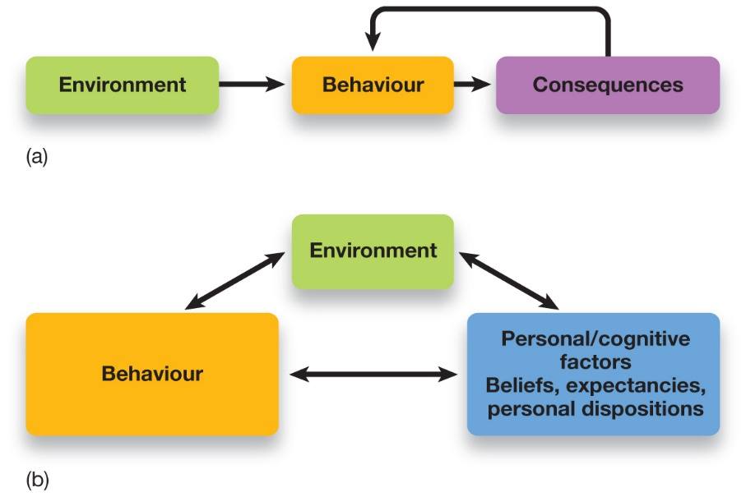
Behaviourist and Social-Cognitive Perspectives
Figure 12.3 Behavioural and Social-Cognitive Approaches to Personality
(a) Behaviourist Account of Personality. Behaviourists thought that what psychologists call personality was an expression of relationships between behaviour, rewards, and punishment. Behaviourists avoided referring to personality traits and dispositions, instead focusing on how past experiences predict future behaviours. For example, whether someone tends to be pessimistic might be based on past experiences of feeling a lost sense of control. (b) Reciprocal Determinism and the Social-Cognitive Approach. According to Albert Bandura and colleagues, personality is a product of dynamic interactions between behaviour and reinforcement, and, importantly, the beliefs, expectancies, and dispositions of the individual.
Source: Ciccarelli, S. K., & White, J. N. (2012). Psychology: An Exploration Subscription) 2nd ed., ©2012. Reprinted and electronically reproduced by permission of Pearson Education, Inc., New York, N Y.
Notes:
1) Behavioural psychologists (Module 1.2) are less concerned with labeling personality traits and shun the use of self-report inventories to measure personality (Figure 12.3).
i) B.F. Skinner believed that personality consists of various response tendencies that occur in different situations.
a) For example, if the situation is a small social gathering, your responses might include dominating the conversation, asking questions, or remaining silent, depending on what responses have been reinforced or punished in the past.
2) Albert Bandura’s social-cognitive learning theory built onto this perspective by exploring the dynamics between people, personality, and their environment (Figure 12.3).
i) According to this perspective, people actively choose their environments in part because they react different to different situations.
a) For example, people who rate low on neuroticism are likely to view the world in a nonthreatening light, whereas those high on neuroticism might hear a honking horn and feel threatened.
b) Those who feel threatened are more likely to choose to be in a more comfortable and tranquil environment.
Reciprocal determinism (p. 468) the idea that behaviour, internal (personal) factors, and external factors interact to determine one another, and that our personalities are based on interactions among these three aspects.
3) Using the social gathering example to compare the two theories:
i) The behaviourist account delineates a simple relationship between asking questions (the behaviour) and having a gathering go well (the consequence).
ii) According to reciprocal determinism, someone who is outgoing chooses to be in an environment in which there will be others with whom to interact, and has a history of finding the experience rewarding.
a) Socializing with others reinforces the behaviours as well as the beliefs and expectations that being with others will be enjoyable.
Long Description:
The two approaches are as follows.
Behaviourist Account of Personality: “Environment” leads to “Behaviour”, “Behaviour” leads to “Consequences”, “Consequences” influence back “Behaviour”
Reciprocal Determinism and the Social-Cognitive Approach: “Behaviour”, “Environment”, and “Personal/cognitive factors” influence are cyclically and also mutually connected.
The chart shows “Personal/cognitive factors” refer to “Beliefs”, “expectancies”, and “personal dispositions.”

Slide 18
12.2 Learning Objectives
Know key terminology associated with cultural and biological approaches to personality.
Understand how evolutionary theories explain personality.
Apply your knowledge to arrive at accurate conclusions about the influences of biological and cultural factors on personality.
Analyze claims that males and females have fundamentally different personalities.
Analyze the genetic basis of personality.
Notes:
Know key terminology associated with cultural and biological approaches to personality.
See the bold, italicized terms below.
Understand how evolutionary theories explain personality.
Evolutionary psychologists speculate that traits such as neuroticism and extraversion evolved because they solved environmental and social problems encountered by our distant ancestors. Although this hypothesis is difficult to test directly, different sources of evidence lend support to it. The widespread occurrence of these personality traits among different species indicates that they are adaptive. Also, modern-day humans use individual differences in personality structure to decide on mating and possibly long-term partner choices.
Apply your knowledge to arrive at accurate conclusions about the influences of biological and cultural factors on personality.
Most psychologists would agree that the Five Factor Model captures important and perhaps universal dimensions of personality, but also might miss important cultural-specific qualities that can only be understood by analyzing personality from that culture’s own perspective. Many interesting differences have been found between cultures (Table 12.2).
Analyze claims that males and females have fundamentally different personalities.
Claims of major gender differences in personality are sometimes made to support popular-book sales. In reality, the general consensus in psychological science is that males and females are more alike than different when it comes to personality. Both, of course, share common personality dimensions. Although females may tend to be, on average, more conscientious and extraverted than males, there is little evidence to support claims that men and women are fundamentally different in personality.
Analyze the genetic basis of personality.
Heritability studies show that personality traits are substantially However, one cannot conclude that personality is “hard wired” and therefore unchangeable. Personality emerges through the interaction of genes and the environment.

Slide 19
Culture and Personality
Personality structures in different cultures
Comparing personality traits between nations
Challenges in cross-cultural research
Response styles (p. 472)
Notes:
Personality Structures in Different Cultures
1) People of other cultures or nations may have unique personality characteristics that are undetected by the Big Five.
i) Most North American studies use North American undergraduate students.
ii) Using the Big Five inevitably imposes a structure of personality onto other cultures.
2) Researchers in China have identified some different factors from the Big Five.
i) These include dependability, social potency, individualism and interpersonal relatedness—which is composed of harmony, tradition, and relationships with others—and dependability.
Comparing personality traits between nations
3) Despite the difficulties noted above, one important advantage of personality scales that have been translated into different languages is that psychologists can test for personality differences across cultures. Many differences have been found (Table 12.2).
Challenges in cross-cultural research
4) Researchers attempting to answer these questions face two central challenges:
i) how to translate measures of personality such that they will mean exactly the same thing in different languages, and
ii) how to ensure that people are using the exact same reasoning process when answering them
a) e.g. response styles (p. 472): characteristic ways of responding to questions; these response styles can be strongly influenced by cultural norms. For example, in one culture it may be more socially acceptable to say highly positive things about yourself, whereas in another culture the same behaviour may be considered rude or boastful.

Slide 20
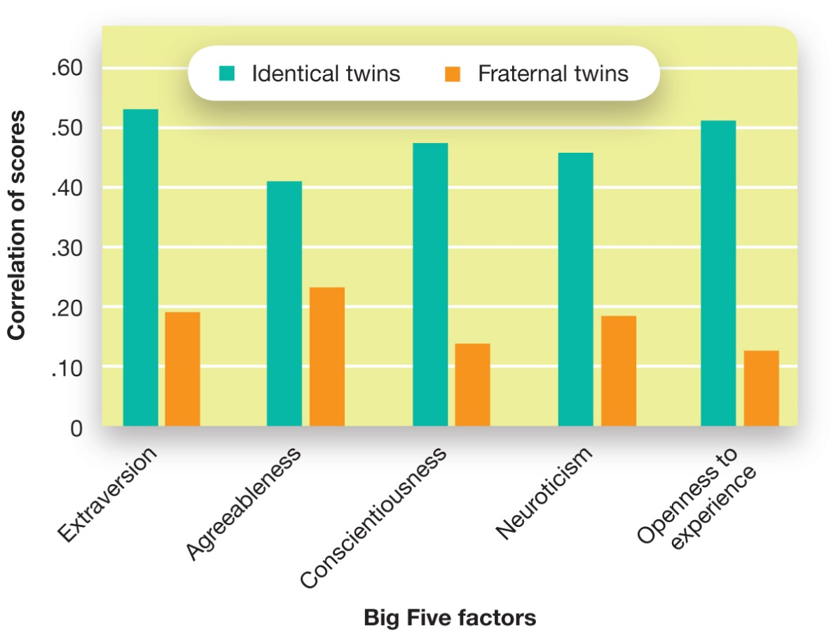
How Genes Affect Personality
Figure 12.4 Genes and Personality
Identical twin pairs show higher genetic correlations than do fraternal twins for each of the Big Five personality traits. Numerical estimates of genetic correlations differ depending on the populations sampled, but studies typically show a genetic basis for each of the five factors (Bae et al., 2013).
Notes:
1) Researchers attempting to tease apart the contributions made by our genes and our environments faced a key challenge, which was that families share not only genes, but also many environmental factors. How then do you know if the pattern you observe is due to the shared genes or the shared environments? The use of twins as research subjects was a brilliant way of overcoming this challenge (see Module 3.1).
i) Research on the Big Five personality traits of twins has shown that identical twins show a stronger correlation for each personality trait than do fraternal twins. The correlations for identical twin pairs are approximately .50 for all five factors, significantly higher than the correlations for fraternal twin pairs (who average approximately .20). This implies that the increased similarity in the personalities of identical twins is due to their shared genes. However, identical twins also tend to share more similar environments than fraternal twins.
ii) To address this, the Minnesota Study of Twins Reared Apart located over 100 sets of twins and triplets who were raised in separate households, and compared them to those raised in the same household. Amazingly, identical twins raised in different households are about as similar to each other as identical twins raised in the same household!
iii) Other studies of adopted children have found that, on average, the personalities of adoptive parents have no influence on the personality characteristics of their adopted children. In fact, siblings who are adopted (i.e., not genetically related) and raised in the same household have been found to be no more similar in personality than two people picked randomly off the street. The genetic influences on personality are strong indeed.
a) It is important to note that this does not mean that parents are incapable of influencing their children’s personality development. Obviously, parents who abuse their children, or on the positive side, parents who put extraordinary efforts into cultivating positive personality traits in their children, are likely to have an impact on their children’s personalities.
Long Description:
The approximate scores are as follows.
Extraversion
• Identical: 0.52
• Fraternal: 0.20
Agreeableness
• Identical: 0.41
• Fraternal: 0.23
Conscientiousness
• Identical: 0.48
• Fraternal: 0.14
Neuroticism
• Identical: 0.46
• Fraternal: 0.19
Openness to experience
• Identical: 0.51
• Fraternal: 0.12

Slide 21
Working the Scientific Literacy Model: From Molecules to Personality (1 of 3)
What do we know about specific genes and personality?
Genes code for brain chemicals related to personality
Serotonin
How do scientists study genes and personality?
Notes:
1) What do we know about specific genes and personality?
i) Scientists have identified genes that code for specific brain chemicals that are related to personality.
ii) For example, one gene that codes for serotonin activity has been found on human chromosome 17.
a) This gene codes for proteins that transport serotonin molecules within the synapses between nerve cells.
b) There are two forms of this gene (i.e., it is polymorphic). The two forms are a short copy and a long copy.
c) Children inheriting short copies from one or both parents are predisposed to anxiety, shyness, and negative emotional reactions in interpersonal situations.
2) How do scientists study genes and personality?
i) One method includes comparing responses on self-report questionnaires of personality in people who have inherited different copies of the serotonin transporter gene.
a) Those who inherit short copies tend to report greater levels of anxiety and neuroticism than those who inherit two long copies.
ii) In another study, researchers took a hair sample from participants to get their DNA to determine which combination of serotonin transporter genes they had.
a) Then participants completed a task that monitored their attentional focus to pictures of positive (e.g., a smiling infant), negative (a black widow spider), or neutral (a kitchen table) stimuli.
b) Those with two short versions of the gene did not avoid looking at the negative images, whereas those with two long copies spent more time looking at positive images.

Slide 22
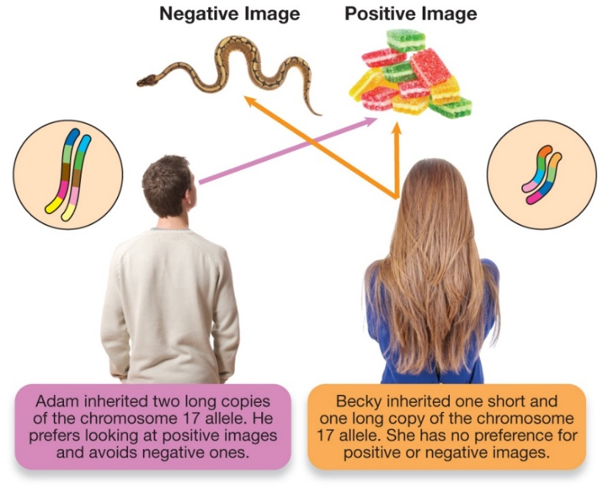
Working the Scientific Literacy Model: From Molecules to Personality (2 of 3)
Figure 12.5 Genes, Serotonin, and Personality
People who inherit two copies of the long version of the serotonin transporter gene fixate on positive images and avoid looking at negative images. People who inherit the short version of this gene are not biased toward attending to positive imagery.
Notes:
1) What do we know about specific genes and personality?
i) Scientists have identified genes that code for specific brain chemicals that are related to personality.
ii) For example, one gene that codes for serotonin activity has been found on human chromosome 17.
a) This gene codes for proteins that transport serotonin molecules within the synapses between nerve cells.
b) There are two forms of this gene (i.e., it is polymorphic). The two forms are a short copy and a long copy.
c) Children inheriting short copies from one or both parents are predisposed to anxiety, shyness, and negative emotional reactions in interpersonal situations.
2) How do scientists study genes and personality?
i) One method includes comparing responses on self-report questionnaires of personality in people who have inherited different copies of the serotonin transporter gene.
a) Those who inherit short copies tend to report greater levels of anxiety and neuroticism than those who inherit two long copies.
ii) In another study, researchers took a hair sample from participants to get their DNA to determine which combination of serotonin transporter genes they had.
a) Then participants completed a task that monitored their attentional focus to pictures of positive (e.g., a smiling infant), negative (a black widow spider), or neutral (a kitchen table) stimuli.
b) Those with two short versions of the gene did not avoid looking at the negative images, whereas those with two long copies spent more time looking at positive images.
Long Description:
The photo shows the man looking at the positive image, candies. A note reads “Adam inherited two long copies of the chromosome 17 allele. He prefers looking at positive images and avoids negative ones.”
The photo shows the woman looking at the positive image, candies, as well as the negative image, a snake. A note reads “Becky inherited one short and one long copy of the chromosome 17 allele. She has no preference for positive or negative images.”

Slide 23
Working the Scientific Literacy Model: From Molecules to Personality (3 of 3)
Can we critically evaluate this evidence?
Multiple genes interact with environment
Should not infer causality
Why is this relevant?
Understanding of biological basis of disorders
Better treatments
Notes:
1) Can we critically evaluate this evidence?
i) It is important to note that It is important to keep in mind that, in most cases, there is no single gene causing a single outcome in a person. Most phenomena are understood to be caused by multiple genes interacting with the environment.
ii) It is also important to note that these are correlational studies, and inferring causality from such data is highly problematic.
2) Why is this relevant?
i) Genetic studies of personality help us better understand the biological basis of psychological disorders such as anxiety and depression.
a) Individuals might be better helped with early detection and treatment.

Slide 24
The Role of Evolution in Personality: Animal Behaviour
Big Five traits found in a number of species
Parus major
Some bold, others shy
Chimpanzees
Extraversion, conscientiousness, and agreeableness
Octopuses
Activity, reactivity, and avoidance
Notes:
The Role of Evolution in Personality
1) Being anxious, bold, curious, open, extraverted, introverted, or conscientious could be adaptive responses to a complex physical and social environment.
i) For example, evolutionary psychologists speculate that jealousy is a trait that evolved for guarding mates.
a) Jealousy is one way that individuals advertise that their mate is unavailable— and can be expressed both to one’s partner and to anyone jeopardizing the relationship.
Animal Behaviour: The Evolutionary Roots of Personality
1) It turns out that several of the Big Five personality traits have been found in a rich diversity of species—such as hedgehogs, ants, rhinos, and primates.
i) For example, scientists have studied one particular species of bird (Parus major) that lives in Europe and Asia.
a) One personality type is bold in its exploration of new environments and less responsive to external stimuli.
b) The other type is more timid, less exploratory, and more reactive to external stimulation.
2) In one study, a list of adjectives was taken from the Big Five test and people who were familiar with the chimpanzee subjects rated how well the adjectives applied to each chimp on a 1 to 7 scale.
i) Of the Big Five traits, extraversion, conscientiousness, and agreeableness were reliably found in the chimps.
3) Octopuses also show stable individual differences in measures of activity, reactivity, and avoidance.

Slide 25
Why There Are So Many Different Personalities: The Evolutionary Explanation
Core personality traits across cultures
Individuals select environments that match personality characteristics
Notes:
1) The consistent appearance of core personality traits across cultures and species indicates that these traits have been important to survival.
i) However, personality is flexible, which allows us to fill diverse social and environmental niches.
2) Evolution involves changes in traits that occur within reproducing populations over many generations; it occurs at the level of populations.
i) Therefore, individual differences have traditionally been regarded as evolutionary “noise.”
a) One individual within an entire breeding population cannot have much of an effect on how a trait evolves.
3) However, the relationship between personality and evolutions may mean that individual differences are not so random.
i) Our personalities guide decisions about with whom we associate, where we choose to go to school, etc.
ii) The extravert and the introvert, the neurotic and the tranquil, and the conscientious and the careless gravitate toward the respective niches they best fill. People tend to select environments that suited their personality characteristics and actively avoided those that might lead to discomfort.

Slide 26
MYTHS IN MIND: Men are from Mars, Women are from Venus
Gender differences greatly exaggerated
Influenced by resource availability
Notes:
1) Men and women tend to differ in some personality dimensions. However, these differences are often greatly exaggerated.
i) This happens especially in the pop psychology industry with such books as Men Are from Mars, Women Are from Venus.
2) Cross-cultural studies have shown that women generally report higher levels of extraversion, conscientiousness, agreeableness, and neuroticism than men.
i) However, these differences are small and may be explained by economic factors.
3) Countries showing the largest gender differences in personality also have greater access to resources such as health care, education, and wealth.
i) Men and women in countries with fewer social and economic resources tend to be more similar in their self-reported personality scores.

Slide 27
The Brain and Personality
Four Humours (400 BC)
Phrenology (1700s)
Extraversion and arousal: brain regions (1967)
Approach/Inhibition model of motivation (1991)
Notes:
1) According to ancient medicine (circa 400 BC), the body consisted of four humours—including blood, phlegm, black bile, and yellow bile.
Humourism (p. 478) explained both physical illnesses and disorders of personality as resulting from imbalances in key fluids in the body—the four “humours.”
i) For example, too much black bile resulted in melancholy.
2) In the late 1700s, the German doctor Franz Gall developed phrenology.
Phrenology (p. 478) was the theory that personality characteristics could be assessed by carefully measuring the shape of the skull.
i) This theory held well into the 1800s.
3) Hans Eysenck (1967), was a pioneer in linking personality characteristics with specific brain regions.
i) He proposed that arousal states of the brain are the basis of extraversion and that the reactivity of the limbic system (the emotional circuits) are correlated with extraversion.
Arousal theory of extraversion (p. 478) argues that extraversion is determined by people’s threshold for arousal.
Ascending reticular activating system (ARAS) (p. 478) plays a central role in controlling this arousal response.
ii) Research on Eysenck’s ideas has demonstrated that extraverts do have less reactive ARASs compared to introverts.
4) Jeffrey Gray proposed another influential model of the brain–personality relationship: the approach/inhibition model of motivation
i) This model describes two major brain systems for processing rewards and punishments: the behavioural activation system and the behavioural inhibition system.
Behavioural activation system (BAS) (p. 478) is a “GO” system, arousing the person to action in the pursuit of desired goals.
Behavioural inhibition system (BIS) (p. 478) is more of a “danger” system, motivating the person to action in order to avoid punishments or other negative outcomes.
ii) Several of the Big Five factors are correlated with activation of the BIS/BAS systems. The most consistent finding is that extraversion is especially related to BAS activation, whereas neuroticism is related to BIS activation.

Slide 28
12.3 Learning Objectives
Know the key terminology related to psychodynamic and humanistic approaches to personality.
Understand how people use defense mechanisms to cope with conflicting thoughts and feelings.
Understand the developmental stages Freud used to explain the origins of personality.
Apply both psychodynamic and humanistic perspectives to explain personality.
Analyze whether projective tests are valid measures of personality.
Analyze the strengths and weaknesses of psychodynamic perspectives.
Notes:
Know the key terminology related to psychodynamic and humanistic approaches to personality.
See the bold, italicized terms below.
Understand how people use defense mechanisms to cope with conflicting thoughts and feelings.
Defense mechanisms become active whenever our unconscious drives come into conflict with the ego and/or the superego. These mechanisms may involve repressing urges, displacing them, or even finding subtle, more acceptable ways of expressing those urges.
Understand the developmental stages Freud used to explain the origins of personality.
To explain personality development according to Freud, we begin with the concept of libido—the id’s energy source for the drives that originate at different focal points of the body, from infancy to adolescence. Each of the stages of psychosocial development—oral, anal, phallic, latent, and genital—is associated with a unique form of conflict as the ego and superego develop. Failure to resolve the corresponding conflict can result in a fixation.
Apply both psychodynamic and humanistic perspectives to explain personality.
Using Table 12.4, students should be able to read about situations and describe them from Freud’s perspective. Students should also be able to read scenarios and determine how far a person had developed according to Maslow’s hierarchy of needs.
Analyze whether projective tests are valid measures of personality.
In this Module, students learn about projective tests such as the Rorschach inkblot test and the Thematic Apperception Test, which some believe allow psychologists to tap into the unconscious world. Although research does suggest that we process information without being aware of it, projective tests do not appear to be valid ways of accessing what is being processed.
Analyze the strengths and weaknesses of psychodynamic perspectives.
Psychodynamic theories can provide some compelling explanations for human motivation. For example, it is easy to understand how social and moral conflicts arise when couched in terms of a struggle between the id and the superego. At the same time, this approach does not have a lot of scientific support. It is not possible to objectively identify the structure of an individual’s personality; instead, psychodynamic theorists must rely on subjective interpretations. Attempts at developing more objective projective tests have been largely unsuccessful.

Slide 29
The Psychodynamic Perspective
Unconscious processes and psychodynamics
Sigmund Freud (1800s)
Key observations
Unconscious influences behaviour
Personality forms in early childhood
Mental representations shape behaviours
Notes:
1) Psychodynamic Theories focus on how personality arises through complex interactions involving motivational conscious and unconscious processes that occur from early development on through adulthood.
2) The psychodynamic approach to personality began with Sigmund Freud in the late 1800s.
i) He was an Austrian physician interested in how personality is structured, how it functions, and how disorders arise.
ii) Because he came from a medical perspective, his studies of personality were largely based on individual cases of people who sought his help for psychological problems.
3) Many of Freud’s theories can still be seen in modern psychodynamic theory, which is based on a few key observations:
i) Unconscious thoughts, memories, and emotions operate simultaneously and are major influences on our behaviour.
a) Although we may feel in control of our thoughts and behaviours, unconscious thoughts and emotions can influence our behaviour.
b) Sometimes our thoughts and emotions are in sync and other times they are in conflict.
ii) Personality takes shape in early childhood, and during this period of development, children learn to regulate their emotions.
a) Psychodynamic theorists place a great deal of importance on early childhood experiences.
b) An important part of childhood is learning appropriate and acceptable ways of experiencing and expressing thoughts and emotions.
iii) Mental representations of the self and others shape how the individual acts.
a) The nature of key social relationships, particularly with the parents, determines personality development.
b) During childhood, individuals learn about relationships from interacting with family or other caregivers, and they learn about themselves from the way they are treated.

Slide 30
Unconscious Processes and Psychodynamics
Unconscious mind (p. 483)
Impulses and drives
Conscious mind (p. 483)
Aware of these
Notes:
1) Freud believed that both unconscious and conscious processes control our behaviour.
i) The unconscious mind includes impulses and drives that we are not directly aware of, whereas conscious thoughts are those that you are aware of right now.
Conscious mind (p. 483): your current awareness, containing everything you are aware of right now.
Unconscious mind (p. 483): a much more vast and powerful but inaccessible part of your consciousness, operating without your conscious endorsement or will to influence and guide your behaviours.
2) Laboratory experiments have revealed rather significant discrepancies between conscious and unconscious attitudes, thoughts, and emotions.
i) For example, a person may have been raised to believe in gender and ethnic equality and is aware of these beliefs.
a) He is riled when he overhears a degrading sexist or ethnic remark.
b) This person’s conscious awareness of his thoughts and emotions suggests that he fully believes in equality.
c) A psychodynamic psychologist might say his attitude toward others is based on a well-developed superego.
ii) However, this same person may consistently choose to sit away from members of other ethnicities when he rides a subway.
a) This suggests the individual’s conscious belief in equality may not similarly reside in his unconscious mind.

Slide 31
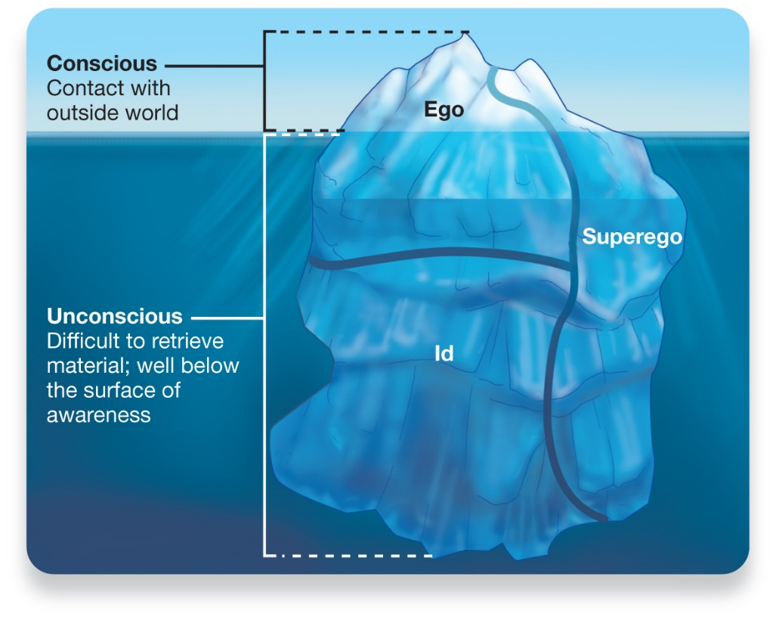
The Structure of Personality
Figure 12.6 Personality Stability and Change over the Lifespan
A popular depiction of how Freud viewed personality features an iceberg, with the unconscious mind residing below the surface and conscious awareness at only the tip of the iceberg. The id is completely submerged, whereas the ego and the superego operate at both unconscious and conscious levels.
Notes:
1) Freud hypothesized the human psyche consists of three hypothetical parts: the id, ego, and superego (Figure 12.6).
i) These parts operate simultaneously, at times in harmony and other times in conflict.
Id (p. 483) represents a collection of basic biological drives, including those directed toward sex and aggression.
2) Freud believed the id was fueled by an energy called libido.
i) The id motivates people to seek out experiences that bring pleasure (e.g., sex, eating, etc.), with little regard for the appropriateness or consequences of their realization.
ii) The id is said to operate according to the pleasure principle, seeking out instant gratification.
a) For example, wikileaks.org released a video of soldiers in a helicopter gunning down a group of men. At times, they were joking and laughing.
b) From Freud’s perspective, everyone has an id that provides the aggressive drives to act as a soldier.
Ego (p. 484) is the decision maker, frequently under tension, trying to reconcile the opposing urges of the id and superego.
3) The ego represents the ability to understand that an individual cannot eat, engage in sexual activity, or otherwise give in to the id all the time.
i) It is said to operate according to the reality principle, delaying the gratification sought by the id until it is socially appropriate.
Superego (p. 484) is comprised of our values and moral standards.
4) The moral composition of the superego is primarily learned from the authority of one’s parents.
i) Going back to the soldier example, superego might nag that “killing is wrong,” and the ego may simply concentrate on the reality of the current situation.
5) Some argue that Freud had a grim perspective of human personality because he believed we were born with the id (born to be bad), whereas we developed the superego with experience.
i) The conflict between the two helps psychoanalysts understand an individual’s personality.
ii) What is especially important is uncovering conflicts that are unresolved, which might result in guilt if the superego wins out, or in hostility if the id is victorious.
Long Description:
The illustration shows an iceberg floating on water. The part of the iceberg above the water is labelled “Conscious (contact with the outside world.” The part of the iceberg below the water is labelled “Unconscious (Difficult to retrieve material; well below the surface of awareness).”
The “Conscious” part of the iceberg is divided into 2 regions, “Ego” and “Superego.” “Ego” forms the major part of “Conscious” and “Superego” forms a small part of the “Conscious.”
The “Unconscious” part of the iceberg is divided into 3 regions, “Ego”, “Superego”, and “Id” as follows.
Ego: It is that part of the iceberg that continues from the top and goes down to half the depth of the iceberg.
Superego: It is that part of the iceberg that continues from the top and goes down to the complete depth of the iceberg.
Id: It is that part of the iceberg that supports the “Ego.”

Slide 32
Defense Mechanisms (1 of 3)
Table 12.3 Examples of Some Major Defence Mechanisms
Defence Mechanism | Definition | Example
Denial | Refusing to acknowledge unpleasant information, particularly about the Self | People deny all sorts of things—ways in which they are to blame for their relationship problems; bad things that other members of their family may be doing; dangerous behaviours, such as drinking while pregnant, that they may be engaged in; and truly, just about anything. Simply blocking distressing things from your mind can be a remarkably effective strategy (until it eventually comes back to haunt you).
Displacement | Transforming an unacceptable impulse into a less unacceptable or neutral behaviour | After getting criticized by your boss at work, you go home and yell at your spouse or criticize your roommate for not doing more housework. One way or another, you “take out your anger” on a less dangerous target than your boss.
Identification | Unconsciously assuming the characteristics of a more powerful person in order to reduce feelings of anxiety or negative feelings about the self | A child acts like their favourite hero-figure or an adult copies a trend-setting celebrity. By associating with a powerful, successful figure, they feel more powerful and successful too.
Notes:
1) Because Freud’s focus was on mental problems, he focused on the conflicts and experiences that invoke anxiety.
i) He worked with his daughter, Anna (another key Figure in early psychodynamic psychology) to explain unconscious conflicts and how individuals deal with such conflicts Table 12.3).
Defense mechanisms (p. 484) are unconscious strategies the ego uses to reduce or avoid anxiety.
2) There is also scientific support for certain defense mechanisms.
i) For example, the person who avoids sitting next to someone of a different ethnicity while on the subway may try to rationalize his/her actions.
a) This person would convince him/herself that his/her choice was based on seating space rather than ethnicity.
ii) Soldiers at war may use humour to reduce the psychological impact of their actions.
a) There is strong correlational evidence suggesting that a good sense of humour helps people manage stress.

Slide 33
Defense Mechanisms (2 of 3)
Defence Mechanism | Definition | Example
Projection | Perceiving in other people the qualities that you don’t want to admit to possessing yourself | The classic insecure, tyrannical parent, who sees hostility and “attitude” in other people, like his kids or his wife, thinking that other people are always seeing themselves as superior and are looking down their noses at others. Projection also allows us to see “evil” and aggression in our enemies while we invade and bomb them.
Rationalization | Attempting to hide your true motives (even from yourself!) by providing what seems like a reasonable explanation for unacceptable feelings or behaviours | People who are prejudiced against certain types or groups of other people may not see themselves as racist, but may instead believe that the group they are prejudiced against actually does possess certain negative qualities. By believing that people from the disliked group are violent, or lazy, or unintelligent, the person never has to confront their own prejudice.
Reaction formation | Altering an impulse that one finds personally unacceptable into its opposite | People who are judgmental and condemning of homosexuality, yet have homosexual impulses themselves. For example, homophobic men tend to have greater penile arousal, compared to non-homophobic men, when looking at male-on-male pornography (Adams et al., 1996).
Notes:
1) Because Freud’s focus was on mental problems, he focused on the conflicts and experiences that invoke anxiety.
i) He worked with his daughter, Anna (another key Figure in early psychodynamic psychology) to explain unconscious conflicts and how individuals deal with such conflicts Table 12.3).
Defense mechanisms (p. 484) are unconscious strategies the ego uses to reduce or avoid anxiety.
2) There is also scientific support for certain defense mechanisms.
i) For example, the person who avoids sitting next to someone of a different ethnicity while on the subway may try to rationalize his/her actions.
a) This person would convince him/herself that his/her choice was based on seating space rather than ethnicity.
ii) Soldiers at war may use humour to reduce the psychological impact of their actions.
a) There is strong correlational evidence suggesting that a good sense of humour helps people manage stress.

Slide 34
Defense Mechanisms (3 of 3)
Defence Mechanism | Definition | Example
Repression | Keeping distressing information out of conscious awareness by burying it in the unconscious | Many people believe that victims of abuse or violence are sometimes able to repress their traumatic memories, essentially “forgetting” that the trauma occurred. Nevertheless, the trauma remains in their unconscious, causing them to react in ways that are driven by this unconscious material.
Sublimation | Transforming unacceptable impulses into socially acceptable or even prosocial alternatives | Someone with a great deal of aggression may become a football player or a boxer. Freud believed that sublimation was one of the cornerstones of civilization, the mechanism by which base human desires were harnessed to give rise to great works of art, invention, and scientific advance. Sublimation operates to make you feel better by finding socially acceptable outlets for unconscious drives and urges.
Notes:
1) Because Freud’s focus was on mental problems, he focused on the conflicts and experiences that invoke anxiety.
i) He worked with his daughter, Anna (another key Figure in early psychodynamic psychology) to explain unconscious conflicts and how individuals deal with such conflicts Table 12.3).
Defense mechanisms (p. 484) are unconscious strategies the ego uses to reduce or avoid anxiety.
2) There is also scientific support for certain defense mechanisms.
i) For example, the person who avoids sitting next to someone of a different ethnicity while on the subway may try to rationalize his/her actions.
a) This person would convince him/herself that his/her choice was based on seating space rather than ethnicity.
ii) Soldiers at war may use humour to reduce the psychological impact of their actions.
a) There is strong correlational evidence suggesting that a good sense of humour helps people manage stress.

Slide 35
Personality Development: The Psychosexual Stages
Table 12.4 Freud’s Stages of Psychosexual Development
Stage | Pleasure Focus | Key Dynamics
Oral (0–18 months) | Actions of the mouth—sucking, chewing, swallowing | This stage is about the foundation of the ego. Fixation at this stage represents a basic lack of self-confidence and “ego-strength,” leaving the person more dependent on, and therefore vulnerable to, external sources of support.
Anal (18–36 months) | Bowel elimination, control | This stage is about the development of a sense of control and competence. Fixation at this stage leads to an “anal retentive” or “anal expulsive” personality, manifesting either as an obsession with cleanliness, order, and control, or as a disorganized person.
Phallic (3–6 years) | Genitals | The key personality challenge is the Oedipus complex, through which a person further develops the superego due to the internalization of values from the parents. Fixation at this stage leads to problems with jealousy and obsessions with power and sex.
Latency (6 years until puberty) | External activities | Ideally, this stage is fairly conflict-free. People focus on developing themselves, discovering their interests through sports, arts, and general activities. Fixation at this stage was not considered to be a big concern.
Genital (puberty to adulthood) | Sexual activities with others | Ideally, this stage is also fairly conflict-free. People focus on fully and authentically engaging in the world, provided they are not fixated at earlier stages.
Notes:
1) Freud believed we were born with the id (impulses for gratification) and that the ego and superego aspects of personality develop through a series of stages, which occur mostly in the first five years of life (Table 12.4).
i) In each stage, pleasurable sensory experiences are focused in different parts of the body, and the id is driven to experience as much as possible
2) Those who have trouble transitioning between stages may develop a fixation.
Fixation (p. 486) involves becoming preoccupied with obtaining the pleasure associated with a particular stage as a result of not being able to adequately regulate themselves and satisfy their needs at that stage.
i) For example, when you are an infant in the oral stage, everything is great—you cry and you get fed.
a) Then weaning suddenly begins, and you’re told you have to wait to eat, which is the first time you’re told “no.”
ii) If you have trouble with this transition, you may develop an oral fixation later in life, such as biting your nails or excessive gum chewing.
3) Freud proposed that individuals go through the following sequence of psychosexual stages:
i) Oral stage: During this stage, pleasure is derived from actions involving the mouth.
a) Breastfeeding is the most obvious pleasurable activity at this stage.
b) Fixations may result in overindulgence or deprivation from breastfeeding when needed as an infant.
c.) Fixations in adulthood may lead to excess eating, drinking, and smoking, or the opposite (avoiding oral stimulation as much as possible).
ii) Anal stage: Stimulation relating to bowel movements is the source of pleasure during this stage.
a) Toilet training plays a central role in passage through this stage.
b) Fixation at this stage results in being excessively neat and organized (anal-retentive) or, on the opposite end of the spectrum, a person who becomes sloppy and messy.
iii) Phallic stage: This is a key stage in psychosexual development, as it is when children begin to show interest in their own genitals.
a) Children in this stage are said to become sexually attracted to the opposite-sexed parent.
b) The male child develops a sense of competition with his father, and then begins to fear that his father will castrate him in the course of competing for affection of the mother (the Oedipal complex).
c) The female fixation manifests itself in what Freud termed penis envy, in which girls are believed to fantasize about having a penis.
iv) Latent stage: The libido is dormant is this stage.
a) The focus is building friendships with same-sex peers.
v) Genital stage: This stage is marked by the onset of puberty and continues throughout adulthood.
a) Interest in mature, sexual relationships begins.
b) Unresolved conflicts at earlier stages of psychosexual development may impede the development of mature sexual relationships at this stage and into adulthood.
4.) Modern psychodynamic psychologists generally do not agree that Freud’s stages of psychosexual development are directly applicable to personality development.
i) However, clinical psychologists have observed children showing more affection toward the same-sexed parent and aggression toward the opposite-sexed parent.
a.) This is reminiscent of the Oedipal complex, although there is no reference to sexual attraction toward the opposite-sexed parent.

Slide 36
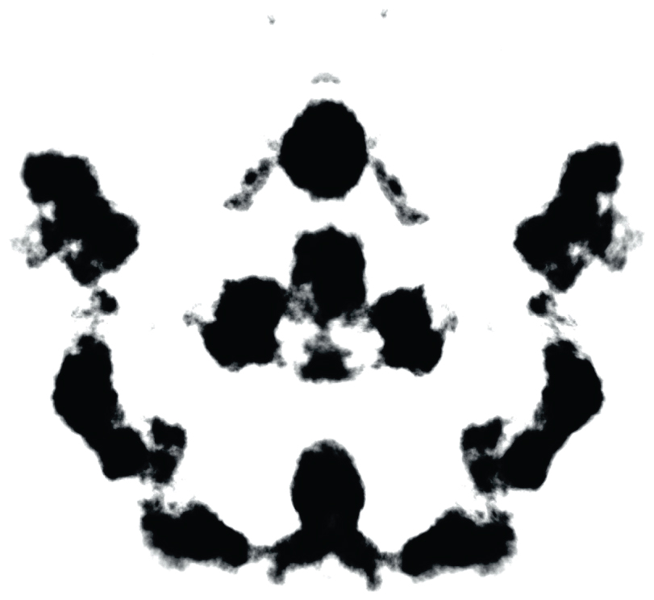
Exploring the Unconscious with Projective Tests (1 of 3)
Figure 12.7 The Rorschach Inkblot Test
Some psychologists attempt to measure personality characteristics by analyzing the verbal responses clients use to describe what they see in an inkblot such as this (which clearly shows an image of your parents).
Notes:
1) There is a challenge to uncovering something that is, by definition, unavailable to consciousness.
2) Freud employed techniques such as dream analysis; that is, he viewed dreams as direct links to the unconscious mind.
i) Because the id does not use language, the conscious mind can make sense of dreams only by interpreting what they symbolize.
ii) Freud also noticed clues to the unconscious in the little things people do, a gesture, a slip of the tongue, or even a joke.
3) Modern psychodynamic psychologists have attempted to develop more standardized techniques for probing the unconscious.
Projective tests (p. 488) are personality tests in which ambiguous images are presented to an individual to elicit responses that reflect unconscious desires or conflicts.
i) They are called projective because an individual’s description of the image is thought to be a projection of his/her own thoughts and personality.
4) One of the most familiar projective tests is the Rorschach inkblot test (Figure 12.7).
Rorschach inkblot test (p. 488) subjects are asked to describe what they see on the inkblot, and psychologists attempt to interpret what the subject projects onto the stimulus by using a standardized scoring and interpretation method.

Slide 37
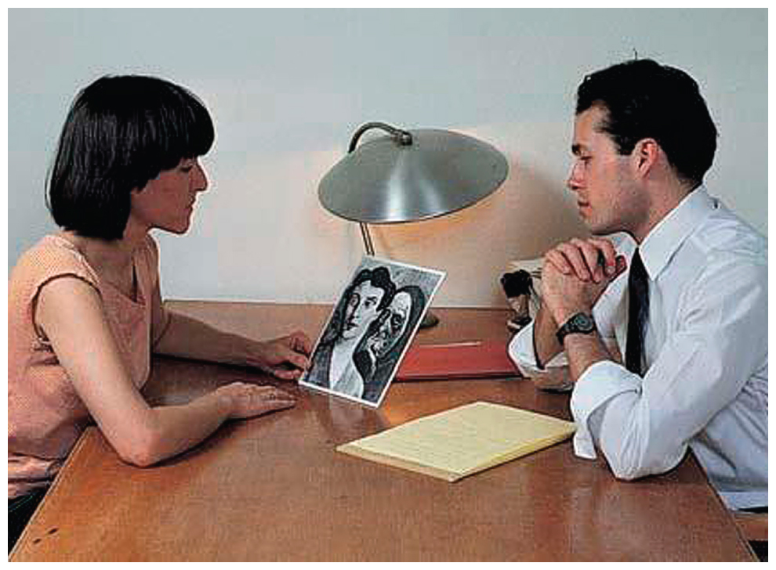
Exploring the Unconscious with Projective Tests (2 of 3)
Figure 12.8 The Thematic Apperception Test
In this projective test, the individual is asked to tell a story about what is happening in the image. The responses to this task are believed by some to give important insights into an individual’s personality.
Notes:
5) Another popular projective test is the Thematic Apperception Test (TAT) (Figure 12.8).
Thematic Apperception Test (TAT) (p. 488) asks respondents to tell a story about a series of 31 pictures involving ambiguous interpersonal situations.
i) For example, a person may be shown a picture of a couple looking at each other with blank expressions and asked to tell a story about the picture.

Slide 38
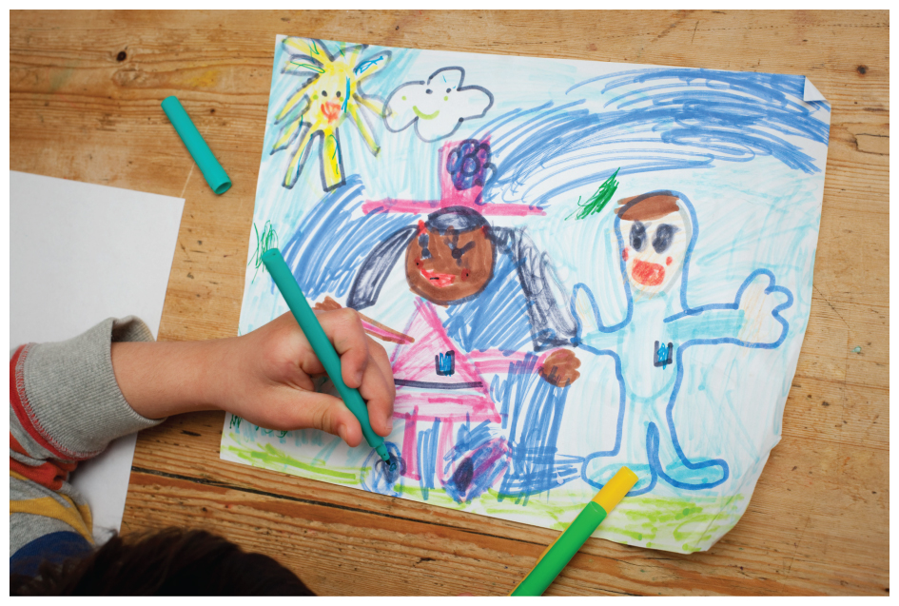
Exploring the Unconscious with Projective Tests (3 of 3)
Figure 12.9 Figure Drawing as a Projective Test
Figure drawing is another projective technique used by many psychologists. The content of the drawings is analyzed and interpreted by the therapist. It turns out that these drawings are somewhat related to artistic ability and intelligence, but not personality (Lilienfeld et al., 2000).
Source: Scott O. Lilienfeld, James M. Wood and Howard N. (2000). Garb Psychological Science in the Public Interest, 1(2), 27–66.
Notes:
6) Two particularly important concepts come into play when it comes to evaluating psychological testing: reliability and validity (Module 2.1).
i) The reliability of a test refers to how consistently it yields similar results.
a) In the case of projective tests, two or more therapists who analyze responses should come up with the same, or very similar, conclusions.
ii) The validity of a test refers to how well the test measures what it is intended to measure.
b) For example, the Figure-drawing test (Figure 12.9) appears to measure a combination of personality, artistic ability, and intelligence.
iii) Research often indicates serious limitations regarding the reliability and validity of projective tests.
7) Despite criticisms from some researchers, many therapists still use these tests, although their use appears to be on the decline.
i) A survey in the mid-1990s estimated that 43% of clinical psychologists and psychiatrists make frequent use of projective tests.
ii) More recently, a survey of school psychologists showed that the TAT and Rorschach were used by 30% and 14% of these professionals, respectively.

Slide 39
Working the Scientific Literacy Model: Perceiving Others as a Projective Test (1 of 2)
What do we know about the way people perceive others?
We make assumptions of others
May reflect our personality
How can scientists study how projection relates to personality?
Self-ratings on Big Five can been seen in perceptions of others
Notes:
1) What do we know about the way people perceive others?
i) We have a tendency to make assumptions about what others are like, even when limited information is available.
ii) Psychologists suggest our assumptions of others may reflect our own personality.
a) For example, people who exhibit the trait Machiavellianism are generally willing and able to manipulate and deceive others to get what they want.
b) They are also more likely to see others as being cynical and selfish.
iii) In a sense, people project their own personality onto others.
2) How can scientists study how projection relates to personality?
i) In one study, researchers had participants rate their own personality according to the Big Five (Module 12.1), narcissism, and symptoms of psychological depression.
a) They found a general trend in which people who view themselves positively are likely to view others the same way (they project their personality onto others).
b) For example, the participants who rated themselves as agreeable (meaning they make an effort to get along with others and avoid conflict) also tended to rate others as conscientious, emotionally stable, and open to new experiences.

Slide 40
Working the Scientific Literacy Model: Perceiving Others as a Projective Test (2 of 2)
Can we critically evaluate this research?
Small correlations
Only with positive and negative attributions
Why is this relevant?
Problems and controversy with projective tests
Need more objective measures
Notes:
1) Can we critically evaluate this research?
i) There are a number of limitations to what a psychologist can learn about an individual’s personality from their perceptions of others.
a) The correlations are self-ratings and ratings of others are not very large.
b) The projection seems to occur only in terms of positive and negative attributes.
2) Why is this relevant?
i) Projective tests such as the Rorschach inkblot test and the Thematic Apperception Test are fraught with problems and controversy.
a) Modern medical doctors would never use such tests to make any sort of diagnosis.
ii) Psychologists need to continue their search for new, objective methods that might reveal meaningful information.

Slide 41
Alternatives to the Psychodynamic Approach
Carl Jung (1875-1961)
Analytical psychology (p. 490)
Personal, Collective unconscious (p. 490)
Archetypes (p. 490)
Alfred Adler (1870-1937) and Karen Horney (1885-1952)
Inferiority complex (p. 490)
Notes:
1) Swiss psychologist Carl Jung (1875–1961) founded analytical psychology after breaking from Freud professionally and personally.
Analytical psychology (p. 490) focuses on the role of unconscious archetypes in personality development.
i) These archetypes were further defined as mental representations of personality Figures, relationships, and experiences.
ii) Jung believed that in addition to having a personal unconscious, humans also possess a collective unconscious.
Personal unconscious (p. 490) is basically the same as the Freudian unconscious, a vast repository of experiences and patterns absorbed during the person’s life.
Collective unconscious (p. 490) is a separate, non-personal realm of the unconscious that holds the collective memories and mythologies of humankind, stretching deep into our ancestral past.
2) These memories take the form of archetypes.
Archetypes (p. 490) are images and symbols that reflect common patterns of experience across all cultures.
i) The archetypes that Jung identified were thought to organize human thoughts and behaviour, and therefore, personality.
a) According to Jung, all people have an archetype for a mother or father, and a notion of a God.
b) The Hero archetype, often expressed as myth and folklore, represents the universal human belief in a special force or being that wins mighty battles against hated foes.
3) Alfred Adler (1870-1937) and Karen Horney (pronounced HORN-eye) (1885-1952) focused less on sexual conflict and more on the role the social environment played in personality development.
i) Adler believed people developed an inferiority complex.
Inferiority complex (p. 490) refers to the struggle many people have with feelings of inferiority, which stem from experiences of helplessness and powerlessness during childhood.
ii) Instead of sexual conflicts, Horney viewed interpersonal conflict between children and their parents as important to personality development.
a) Also, she rightfully took exception to the notion that females experience penis envy toward males.
4) These divergences from the psychoanalytical approach (as well as others) are due to the limitations in Freud’s theories and work.
i) For example, his theory is said to be sexist, pseudoscientific, and overly focused on the dark sides of humanity.
ii) His theories are also untestable; they cannot be confirmed or rejected.
a) For example, if you denied being sexually attracted to your parent as a child, a Freudian psychoanalyst could say you were just repressing the memories.
iii) His work is based on anecdotal evidence of interactions with a relatively small group of people.
iv) In his defense, many decades-old scientific theories are often regarded as “pseudoscience” by modern standards.
a) He also recognized several important principles still used today, such as the role played by the unconscious and the significance of early experiences in the development of the adult personality.

Slide 42
Humanistic Perspectives
Carl Rogers, Abraham Maslow
Self-actualization (p. 491)
Person-centred perspective (p. 491)
Notes:
1) During the mid-20th century, Carl Rogers and Abraham Maslow were influential humanistic psychologists.
i) Humanistic psychology emphasized the unique and positive qualities of human experience and potential. It was viewed as an alternative to psychodynamic theory as well as to behaviourism, both of which did not acknowledge an important role for free will in human behaviour.
ii) Maslow believed that all humans seek to fulfill a hierarchy of needs.
a) This begins with satisfying basic motivations for food and physical safety and progresses toward more psychologically complex experiences such as feeling a sense of security and love for others and by others.
b) Once basic needs are met, humans seek to achieve self-esteem.
c) The most advanced stage of personality development is reached with self-actualization.
Self-actualization (p. 491) refers to the drive to grow and fulfill one’s potential.
iii) Rogers proposed his person-centred perspective. He believed that humans have the motivation and potential to expand their horizons, mature, and experience all of their capacities.
Person-centred perspective (p. 491) was founded on the assumption that people are basically good, and given the right environment their personality will develop fully and normally.

